Slide 1
Guide to Accessing Microsoft Teams from home

Slide 2
Open up Google Chrome on your computer/laptop
In the address bar type the following:
office.com and press enter
The following window will appear…..

Slide 3
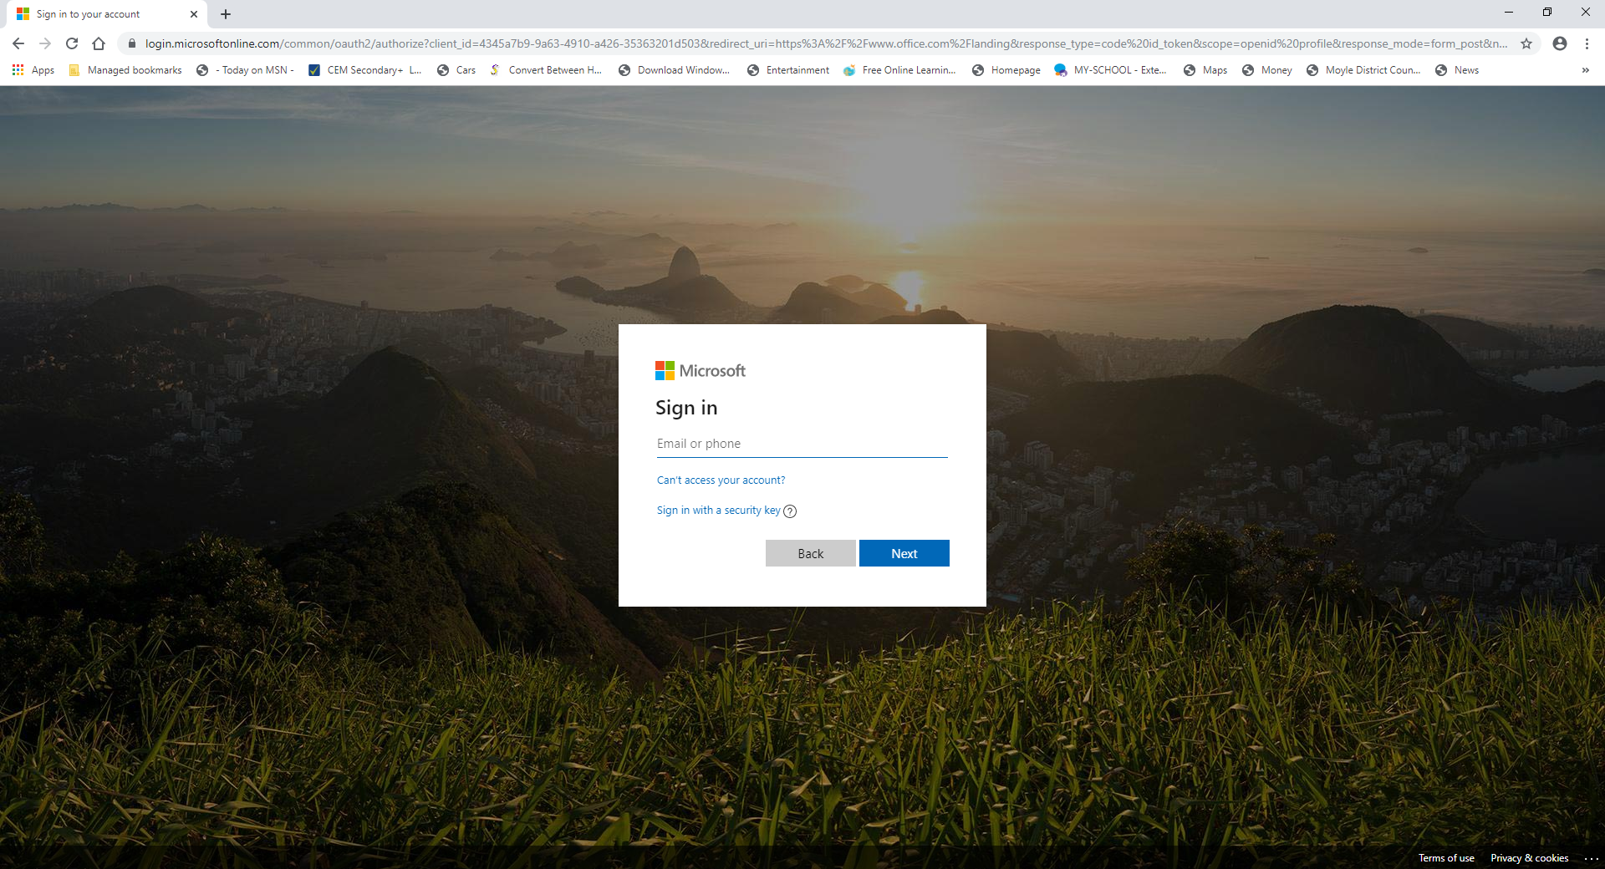

Slide 4
In the Email or phone section you should type the following, replacing jbloggs123 with your normal school username and add the following info:
jbloggs123@c2ken.net
Select NEXT
This will take you to your organisation’s page where you may be asked to sign in again using your school details(username and password)

Slide 5
You will now be taken to the Microsoft Apps page where you will see the icon for Microsoft Teams as well as other apps you may find useful

Slide 6
Click on the
Microsoft Teams icon:
At this stage Microsoft Teams will open up select TEAM from the left hand toolbar and you will see the classes that you have been enrolled into by your teachers.

Slide 7
Select your class and look under the tab ‘FILES’ (top menu bar) where you will find resources that has been uploaded by your teacher. An example is shown below:

Slide 8
In the ‘CHAT’ section along the left of your screen you can chat to your teacher regarding work.
You will need to select their name or use the search bar along the top to find this.
You type your text into the chat bar along the bottom and here you can also use the paperclip symbol to attach a piece of work etc which will be uploaded to your teacher through Microsoft Teams.

Slide 9
By clicking on the ‘FILES’ section in the left toolbar you can access files from your Microsoft One Drive where you should store work you have completed.
You can also download the Microsoft Teams App on your ipad or smart phone and log in using the information provides from slide 4 of this video.
Wishing all our students/parents/carers good health
over this difficult period.

